Slide 1

Università degli Studi di Salerno
1
Dipartimento di Ingegneria dell'Informazione ed Elettrica e Matematica Applicata
Corso di Laurea in
INGEGNERIA INFORMATICA
Software Engineering Project Work
Group 05
Group Members
Esposito Paolo Garofalo Mariachiara Donnarumma Luca Capaldo Vincenzo
Academic year 2023/2024

Slide 2
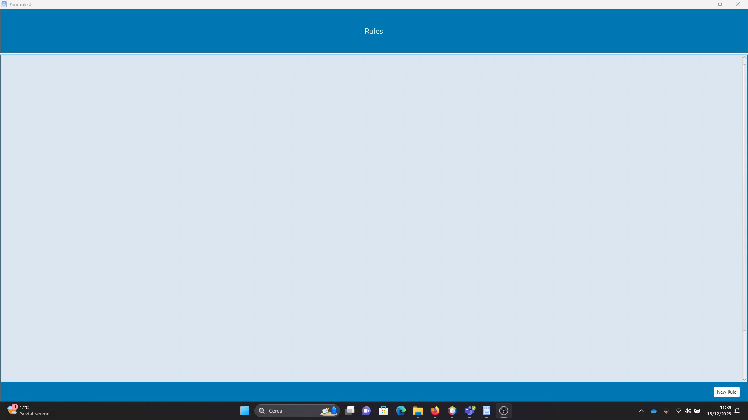
APPLICATION DEMO
2

Slide 3
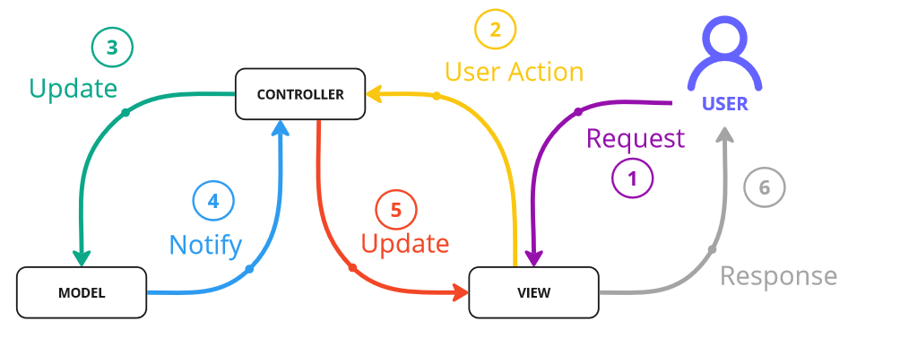
3
Architecture
The architectural style chosen is the Model-View-Controller (MVC).
The Model component takes care of the application logic.
The View component allows the user to interface with the application.
The Controller component act as interface between the other two components.

Slide 4
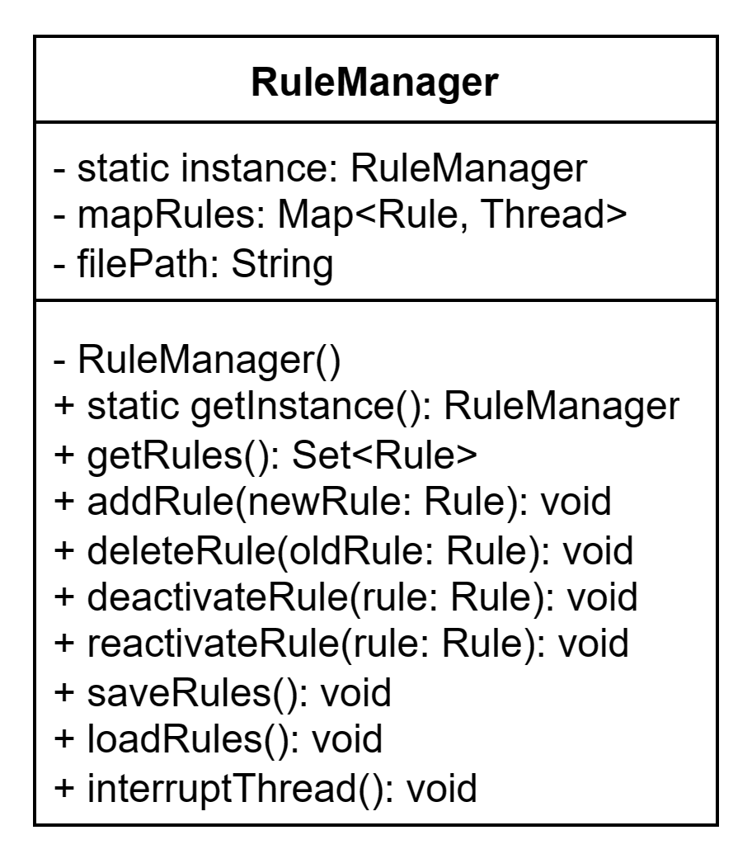
4
Design Patterns
SINGLETON: it is necessary to ensure that RuleManager class has only one instance, so that all other classes access the same instance.

Slide 5
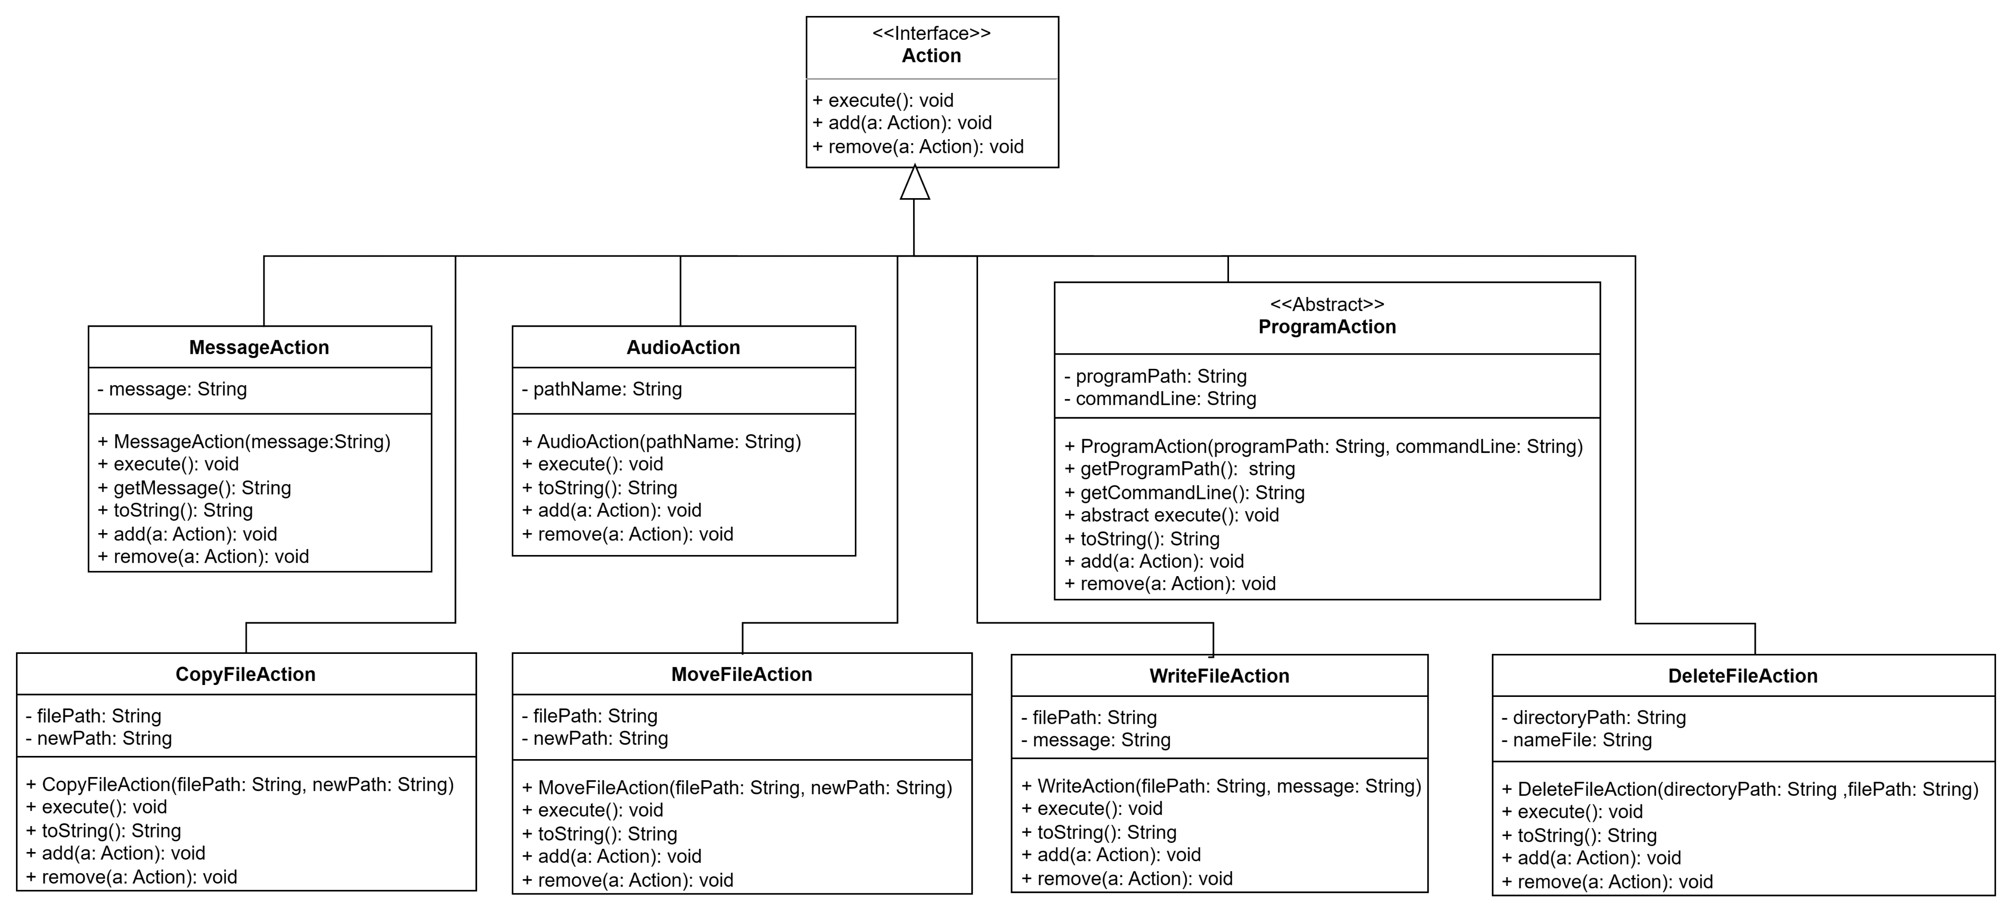
5
Design Patterns
STRATEGY: all actions have the same methods but different implementations.

Slide 6
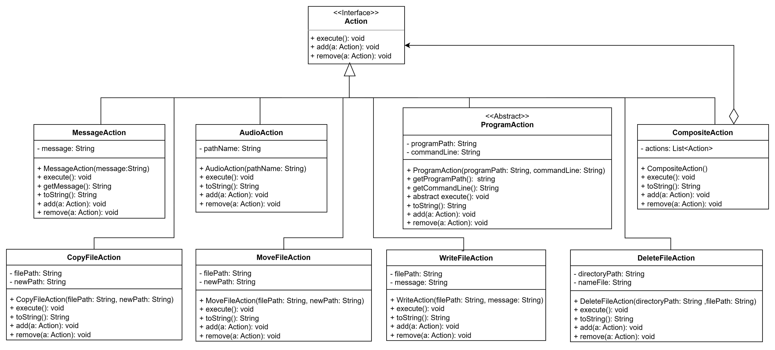
6
Design Patterns
COMPOSITE: CompositeAction is composed of a list of simple action.

Slide 7
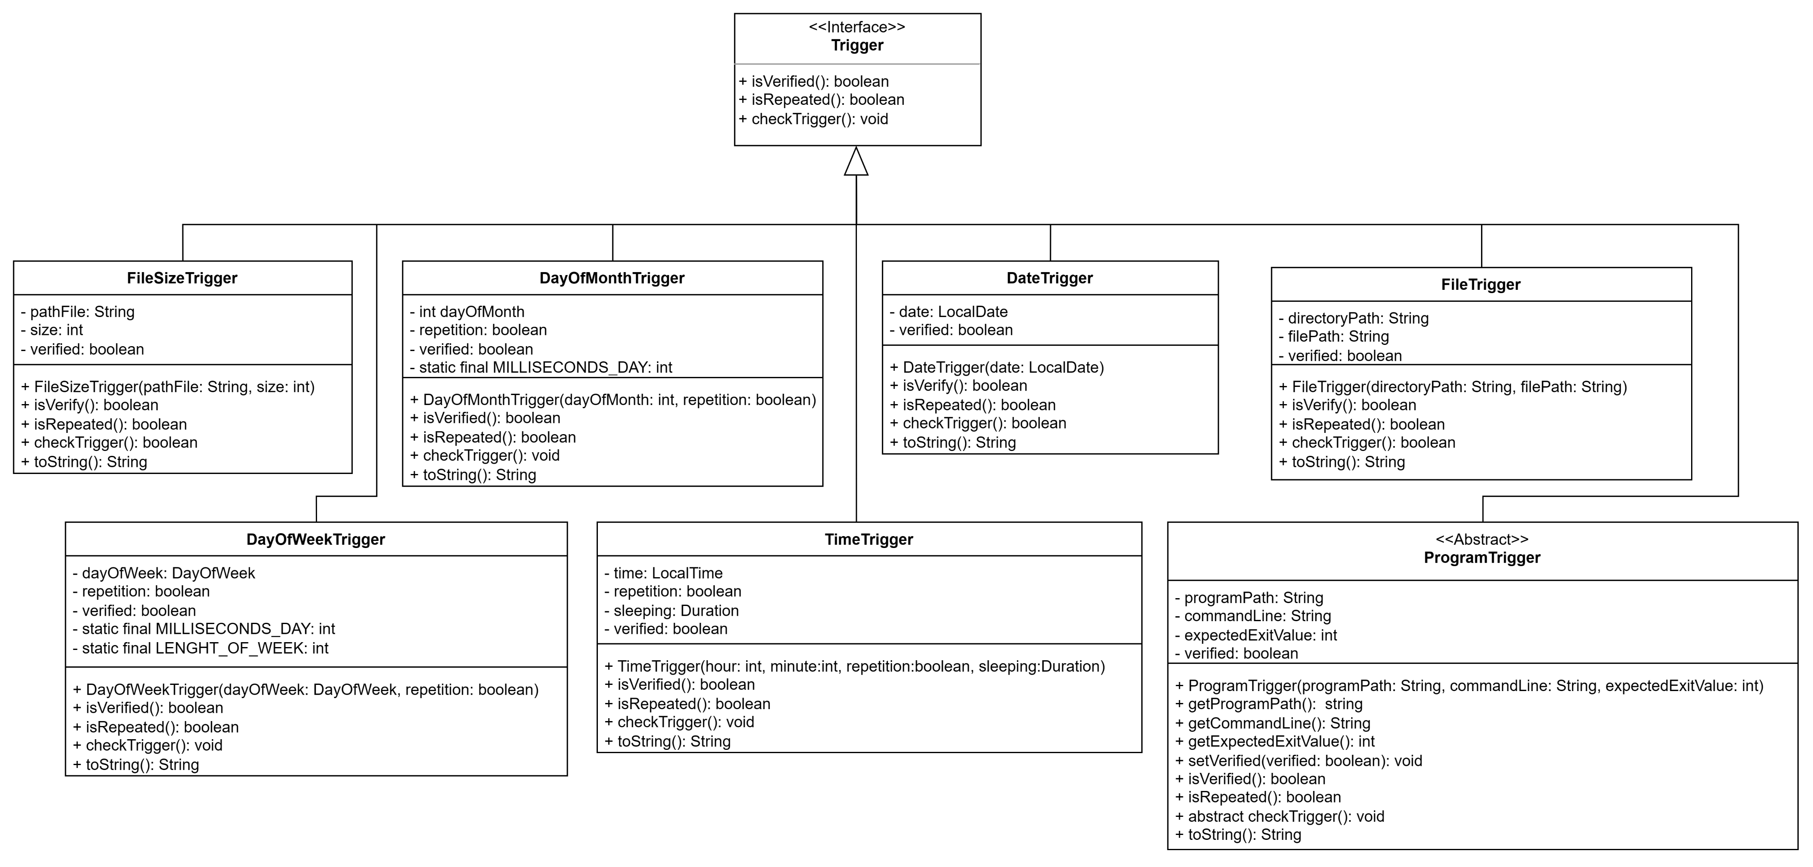
7
Design Patterns
STRATEGY: all triggers have the same methods but different implementations.

Slide 8
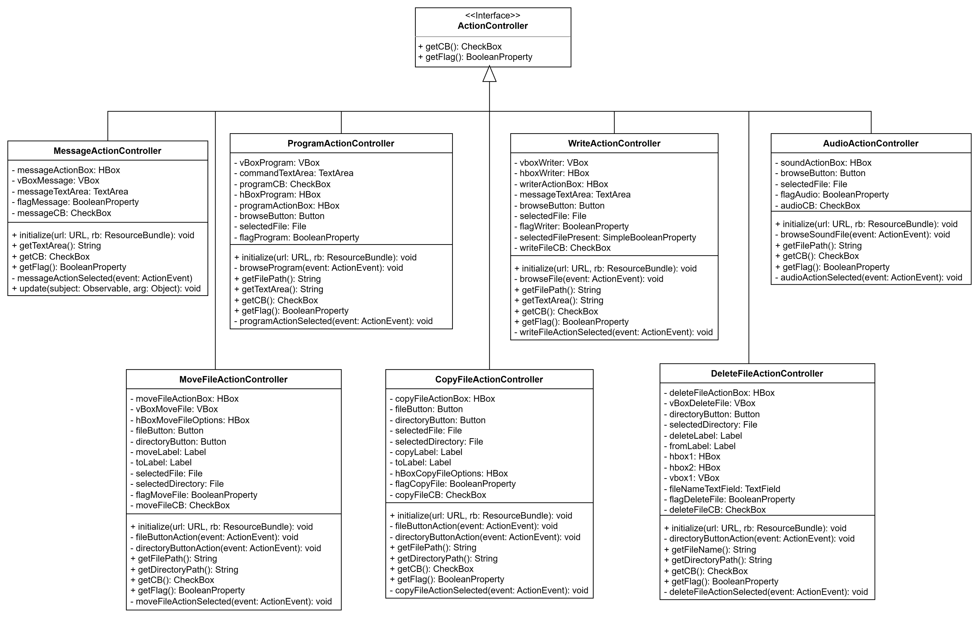
8
Design Patterns
STRATEGY: all ActionControllers have the same methods but different implementations.

Slide 9
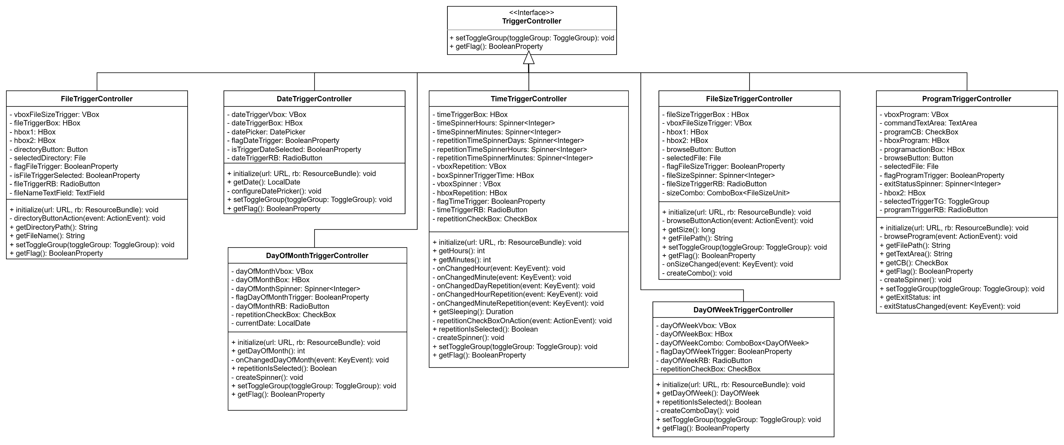
9
Design Patterns
STRATEGY: all TriggerControllers have the same methods but different implementations.

Slide 10
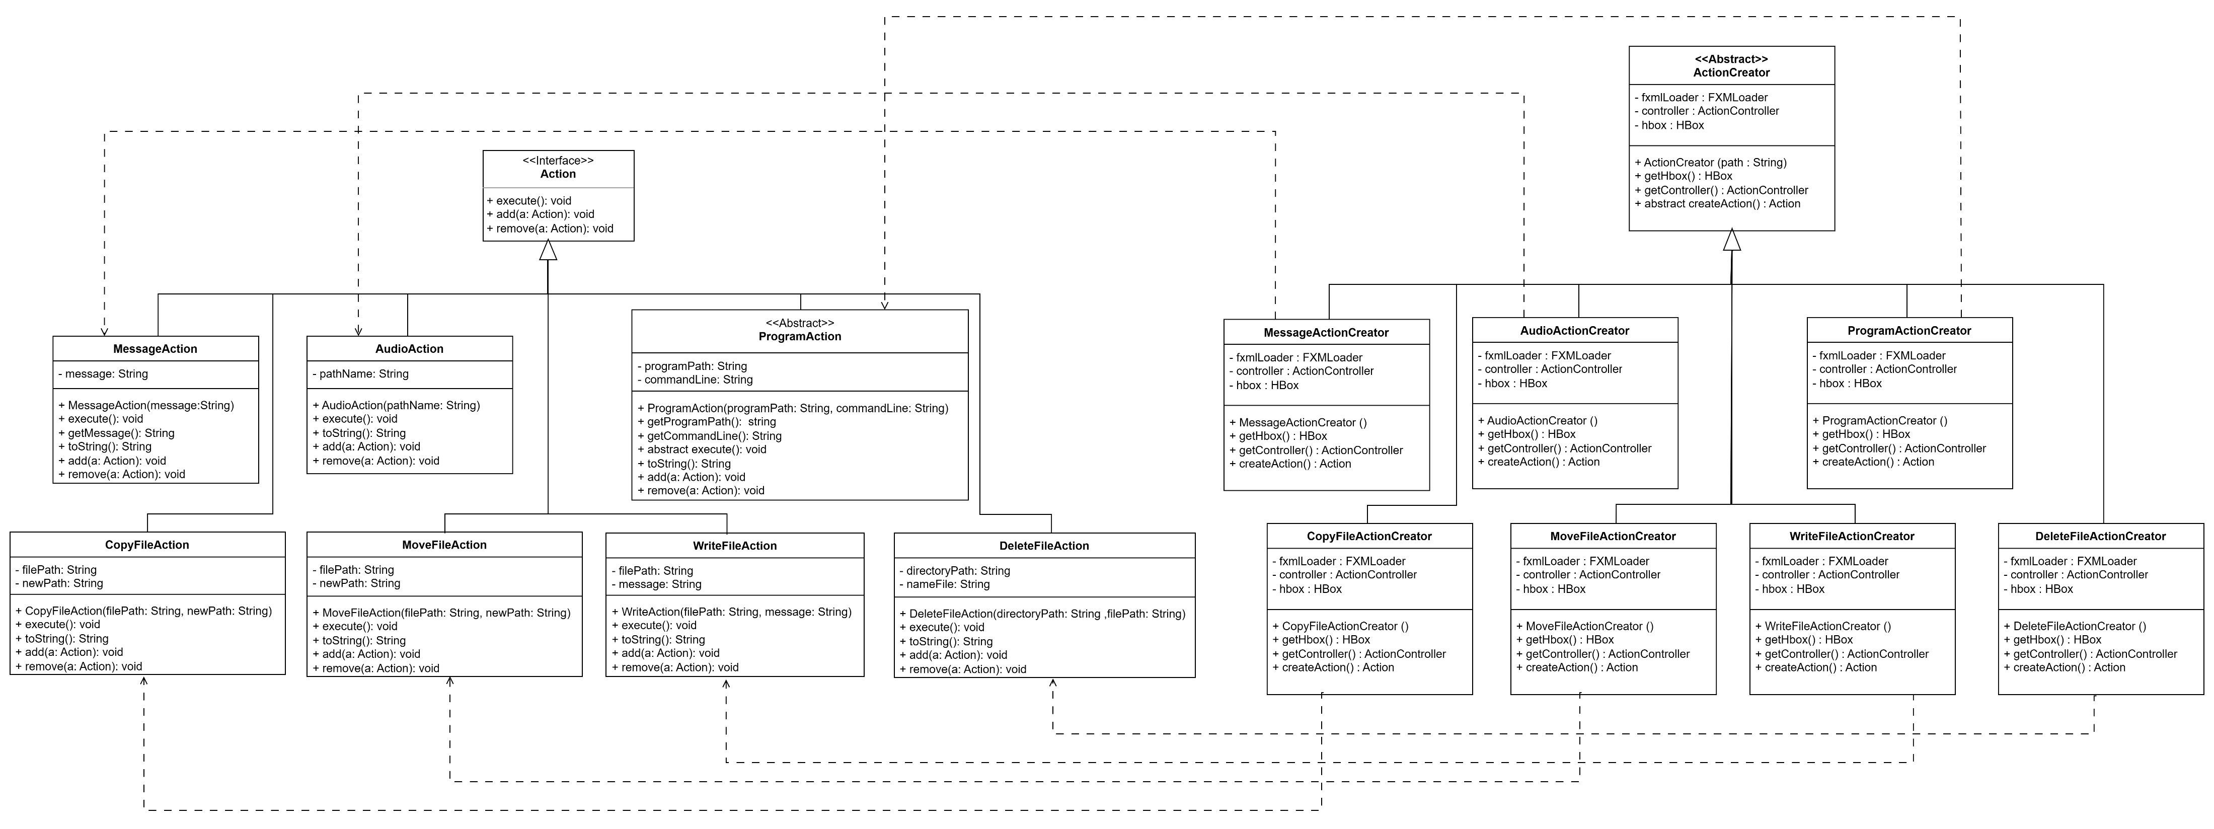
10
Design Patterns
FACTORY METHOD: it is necessary create an “Action” object with a known interface, avoiding dependency on a specific implementation of that interface.

Slide 11
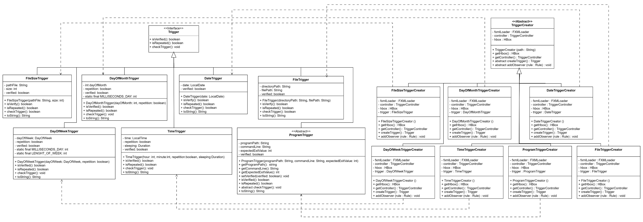
11
Design Patterns
FACTORY METHOD: it is necessary create a “Trigger” object with a known interface, avoiding dependency on a specific implementation of that interface.

Slide 12
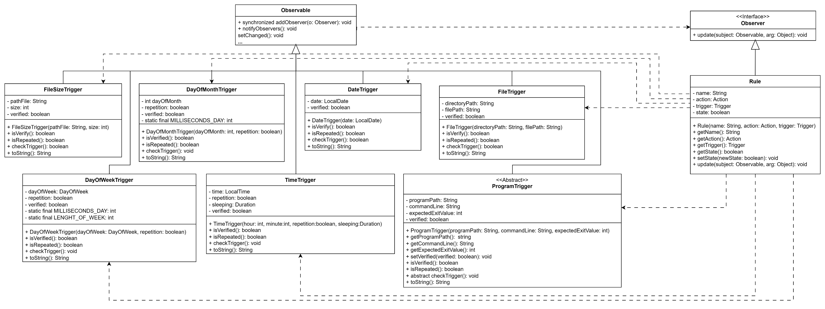
12
Design Patterns
OBSERVER: when a trigger is verified, it notifies Rule, which executes the action associated with the trigger.

Slide 13
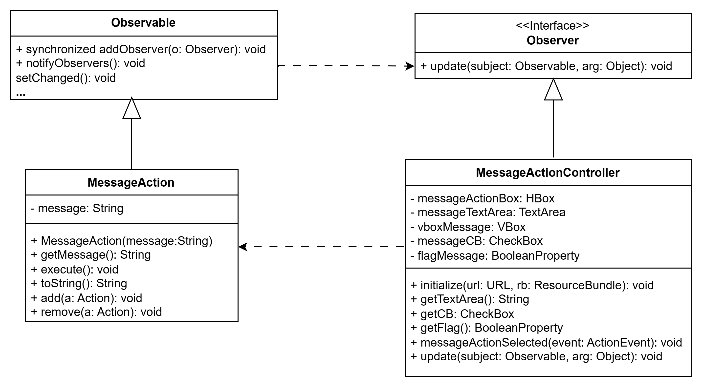
13
Design Patterns
OBSERVER: when MessageAction is executed, it notifies MessageActionController,
which shows a pop up on the screen.

Slide 14
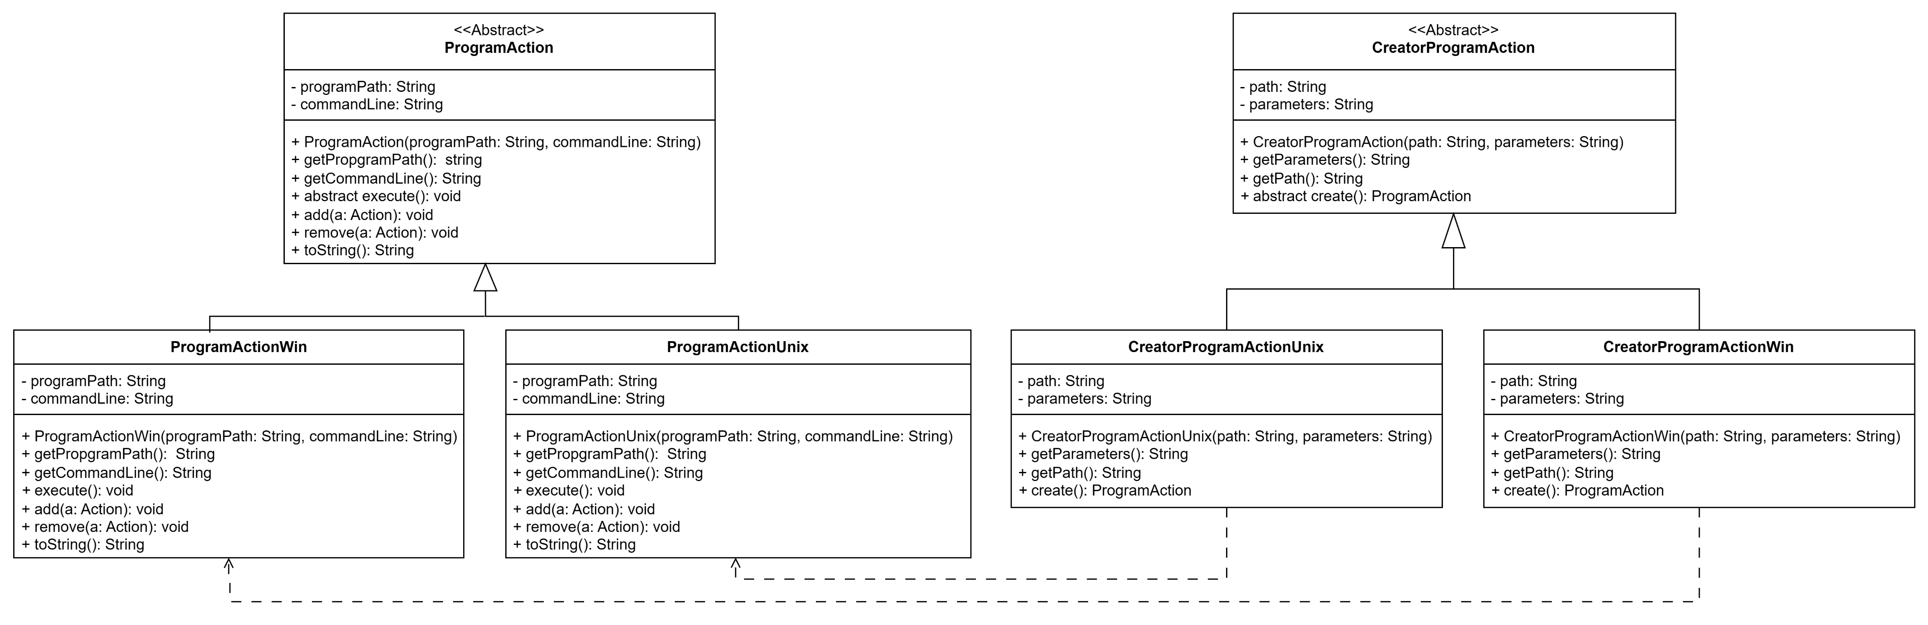
14
Design Patterns
FACTORY METHOD: it is necessary create a “ProgramAction” object with a known interface, avoiding dependency on a specific implementation of that interface.

Slide 15
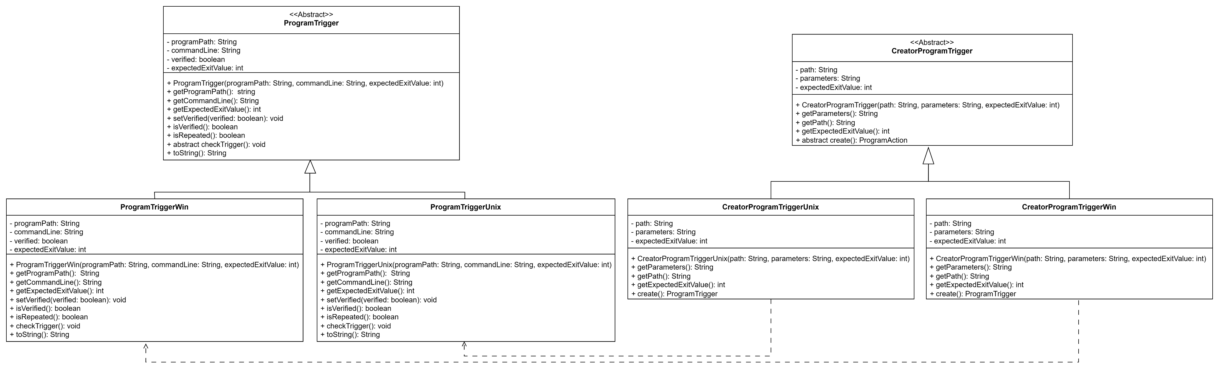
15
Design Patterns
FACTORY METHOD: it is necessary create a “ProgramTrigger” object with a known interface, avoiding dependency on a specific implementation of that interface.

Slide 16
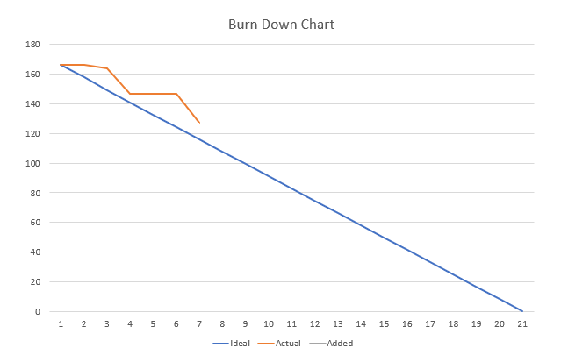
16
Sprint 1 Summary
Project Velocity:
estimated: 48
1° sprint: 39
The ideal line refers to the speed estimated before the beginning of the sprint 1

Slide 17
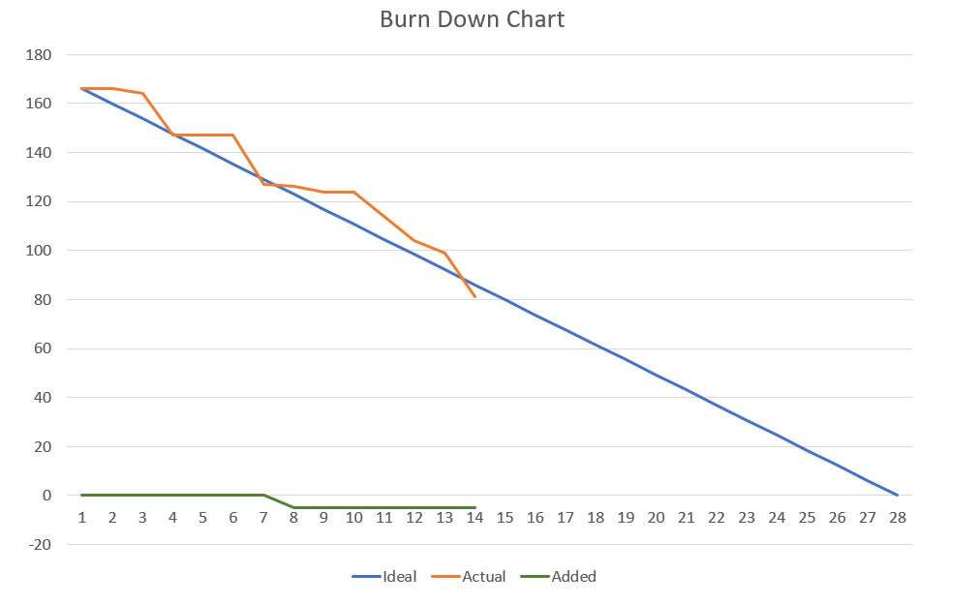
17
Sprint 2 Summary
Project Velocity:
estimated: 48
1° sprint: 39
2° sprint: 46
The ideal line refers to the speed measured at the end of sprint 1

Slide 18
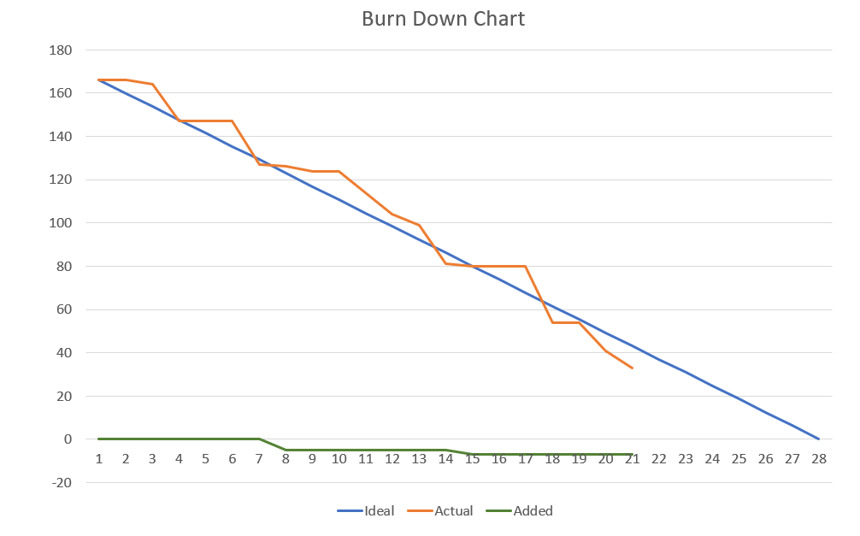
18
Sprint 3 Summary
Project Velocity:
estimated: 48
1° sprint: 39
2° sprint: 46
3° sprint: 48
The ideal line refers to the average of the speeds measured at the end of sprint 1 and sprint 2

Slide 19
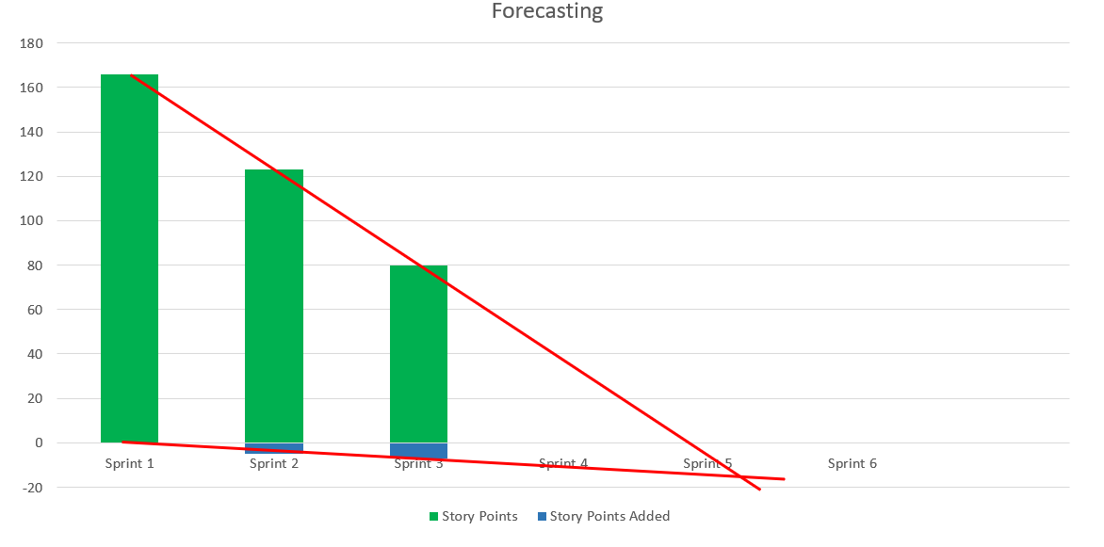
19
Forecasting
By measuring the story points implemented and those added, the application will be released by the sixth sprint

